Slide 1

AIRBNB HOTEL BOOKING ANALYSIS -
Sargam Nagar
INTERNSHIP_17546440516895be537820f

Slide 2

PROBLEM STATEMENT
Analyze the provided Airbnb dataset to understand its structure, identify key characteristics of listings and hosts, assess data quality by handling missing values and duplicates, and explore initial relationships between various features such as price, service fee, location, host attributes, and availability to gain preliminary insights into factors influencing Airbnb listings and their performance.

Slide 3
Project Description
Objective: To explore and understand the characteristics of Airbnb listings, their pricing, and availability using a comprehensive dataset.
Data: Airbnb listing data from "Airbnb_Open_Data.xlsx".
Methodology:
Data Wrangling: Cleaned the dataset by removing duplicates, handling missing values (dropping columns/rows, imputation), and addressing inconsistent data entries ('minimum nights', 'neighbourhood group').
Exploratory Data Analysis (EDA):
Analyzed the distribution of room type and neighbourhood group.
Investigated average price(usd) across different neighbourhood groups and the relationship with Construction year.
Identified top hosts based on calculated host listings count.
Examined the relationship between host_identity_verified status and review rate number using boxplots.
Explored the correlation between price(usd) and service fee(usd).
Visualized average review rate number by neighbourhood group and room type.
Assessed the relationship between calculated host listings count and availability 365 with a regression plot.
Initial Insights: The analysis revealed key distributions of listing types and locations, variations in pricing and review rates across categories, strong correlation between price and service fee, and weak correlation between listing count and availability.
Next Steps: Further analysis can delve deeper into predictive modeling for pricing or review rates, or explore geographic trends.

Slide 4

WHO ARE THE END USERS?
Based on the analysis we've performed on the Airbnb data, the potential end users could include:
Airbnb Hosts: To understand how factors like room type, location, pricing, and host identity verification might affect their review rates, availability, and the number of listings they manage.
Potential Renters/Travelers: To gain insights into typical prices, availability patterns, and review trends in different neighborhoods and for different room types when planning their stays.
Airbnb Platform Administrators/Developers: To understand user behavior, identify trends in listings, and potentially improve the platform based on factors influencing host success and guest satisfaction.
Real Estate Investors/Analysts: To analyze market trends, identify profitable areas, and understand factors influencing property performance in the short-term rental market.
Researchers and Data Scientists: To use the dataset for further statistical analysis, modeling, and gaining deeper insights into the dynamics of the short-term rental market.

Slide 5

Technology Used
The main technologies used in this project are:
Python: The programming language used for the analysis.
Pandas: A powerful library for data manipulation and analysis.
NumPy: A library for numerical operations.
Matplotlib: A plotting library for creating visualizations.
Seaborn: A statistical data visualization library based on Matplotlib.
Google Colab: The cloud-based platform where this notebook is being run, providing the environment and resources for the analysis.

Slide 6
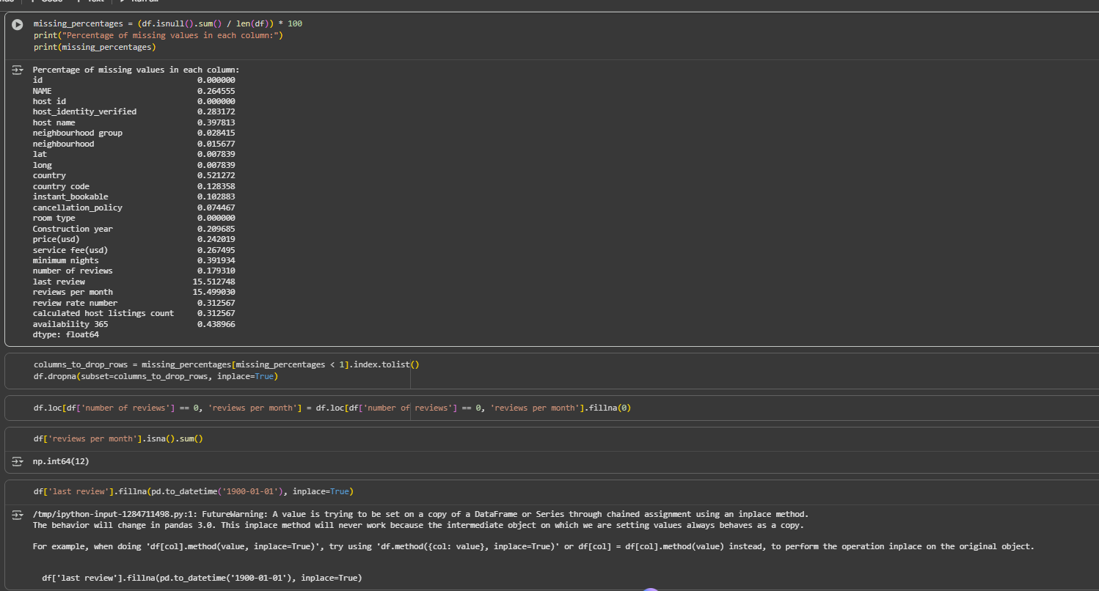
RESULTS1
[Add screen shots of your code or Chart(s) ]
Demo Link

Slide 7
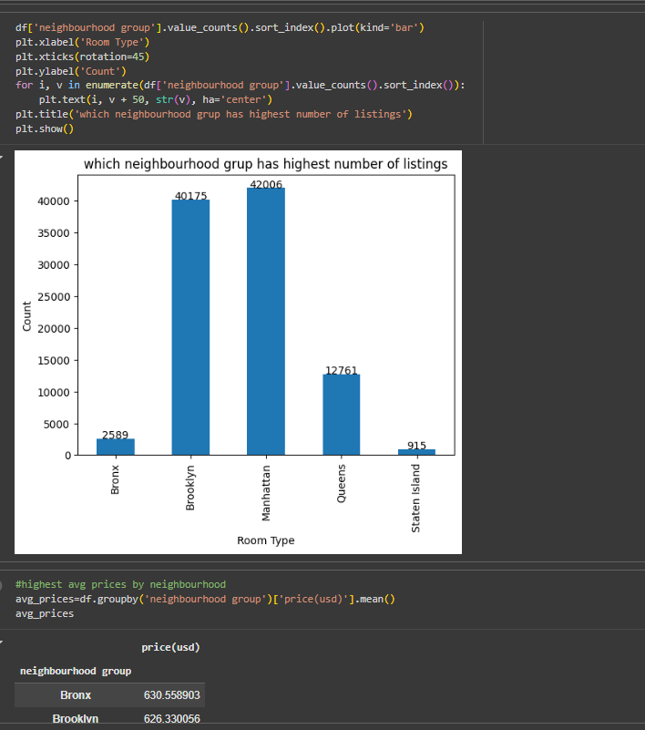
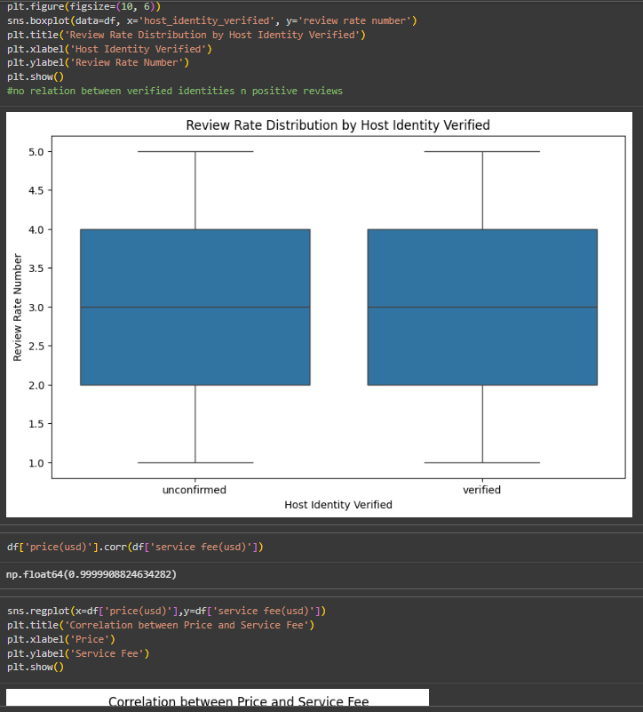
RESULTS2
[Add screen shots of your code or Chart(s) ]
Demo Link

Slide 8
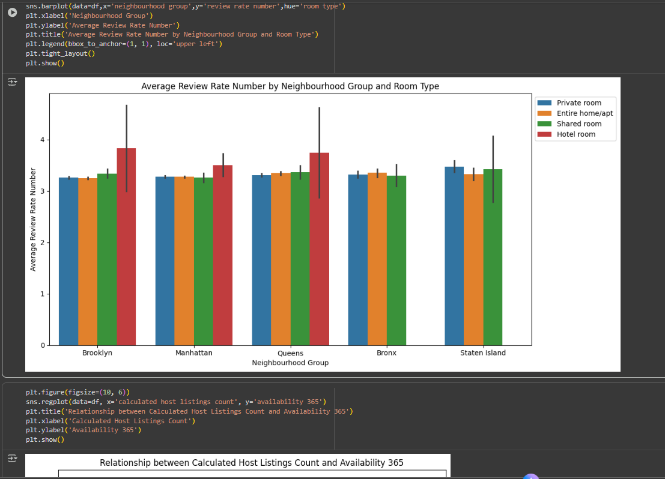
RESULTS3
Demo Link

Slide 9
GitHub repository
https://github.com/srgmnagar/VOIS_AICTE_Oct2025_SargamNagar
Create github repository with format VOIS_AICTE_Oct2025_YourName
Demo Link

Slide 10
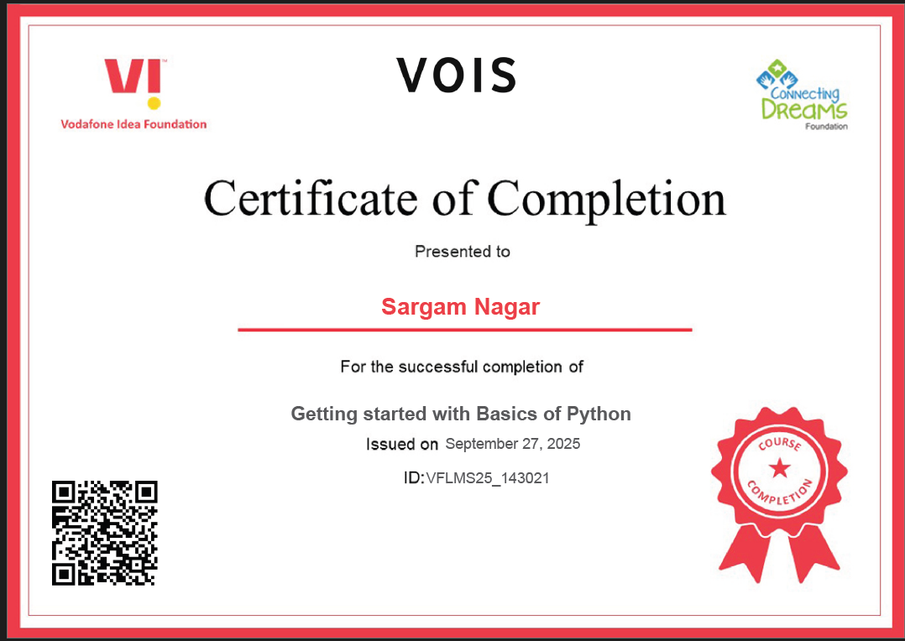
Getting started with Basics of Python Certificate
[Paste your Certificate Here]

Slide 11
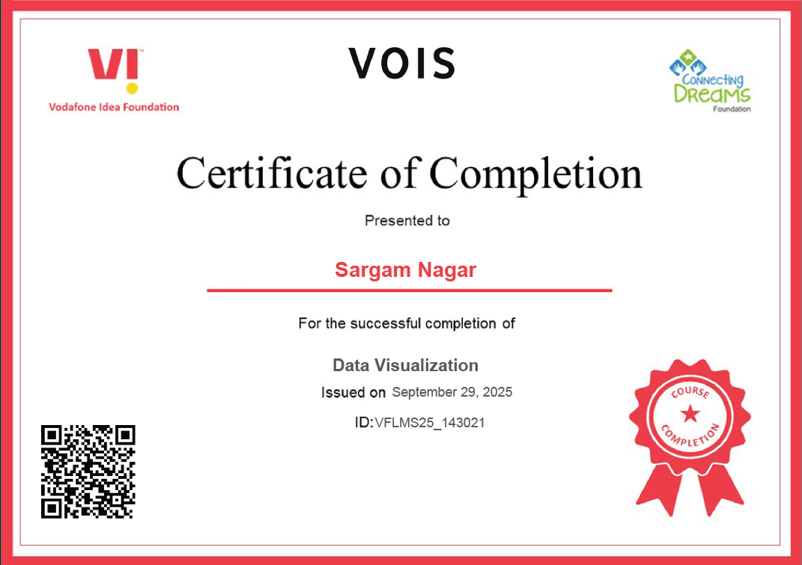
Data Visualization Certificate
[Pasteour Certificate Here]

Slide 12
Thank you
.
.

